Slide 1
Sections 11.1-11.2
Molecular Comparisons and Intermolecular Forces

Slide 2
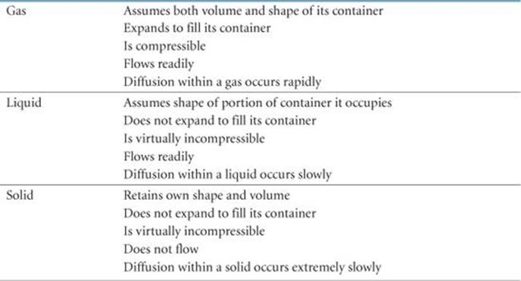
Table 11.1 (page 444)

Slide 3
Chapter 10 Concept
Average kinetic energy of molecules is related to average speed which is proportional to temperature

Slide 4
Intermolecular Forces
Attractive forces that operate between molecules
Gases: very low (allows them to expand in vol)
Liquids: Strong enough to hold them together (definite volume) but weak enough to allow them to move past each other (flow)
Solids: Very strong (cannot compress or flow)

Slide 5
State of Substance
Look at both the kinetic energy and the intermolecular forces!
  Kinetic energy (depends on temp) keeps particles apart and moving
  Intermolecular forces draw particles together
THIS IS HOW HEATING/COOLING RESULTS IN PHASE CHANGE!!
  Temp changes alter the kinetic energy (inc temp=inc energy)
  Pressure changes alter the intermolecular forces (inc press= increase forces)

Slide 6
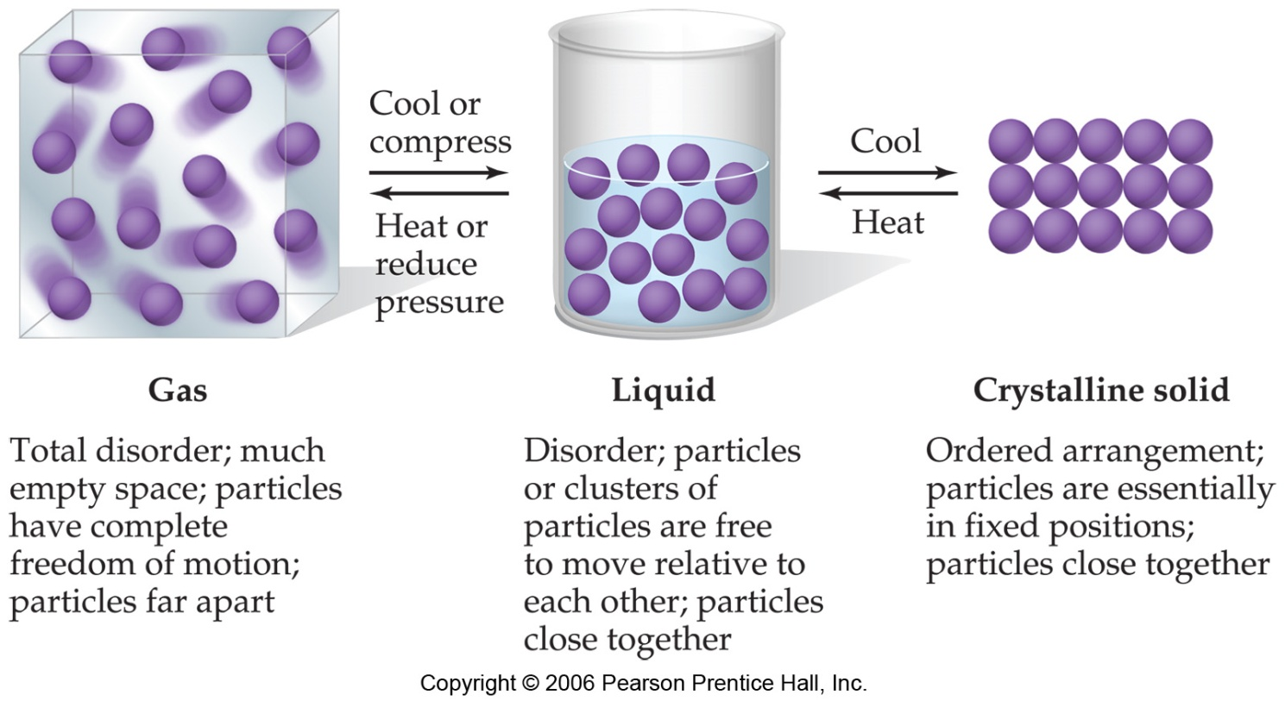
Figure 11.1 p.445
The fundamental difference between states of matter is the distance between particles.

Slide 7
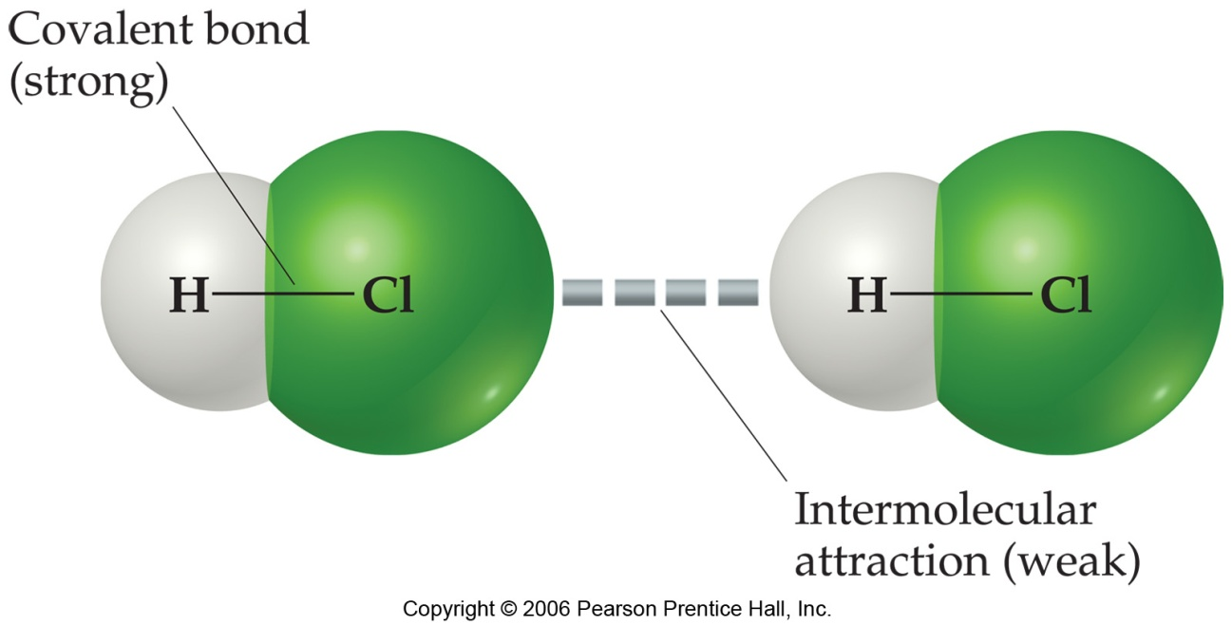
Intermolecular Forces
The attractions between molecules are not nearly as strong as the intramolecular attractions that hold compounds together.

Slide 8
Intermolecular Forces
BUT strong enough to control physical properties (boiling and melting points, vapor pressures, and viscosities)

Slide 9
Intermolecular Attractive Forces
Ion-dipole force
van der Waals forces
  Dipole-dipole interactions
  Hydrogen bonding
  London dispersion forces
All are electrostatic (involving + and – species)
All are less than 15% as strong as intramolecular forces (ionic/covalent)

Slide 10
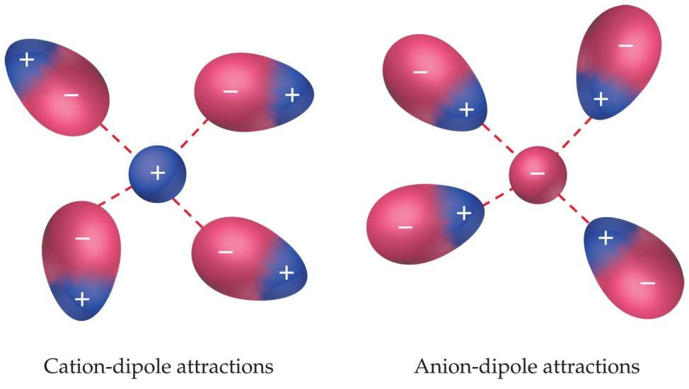
Ion-Dipole Interactions
Force between an ion and the partial charge on the end of a polar molecule
The strength of these forces are what make it possible for ionic substances to dissolve in polar solvents.

Slide 11
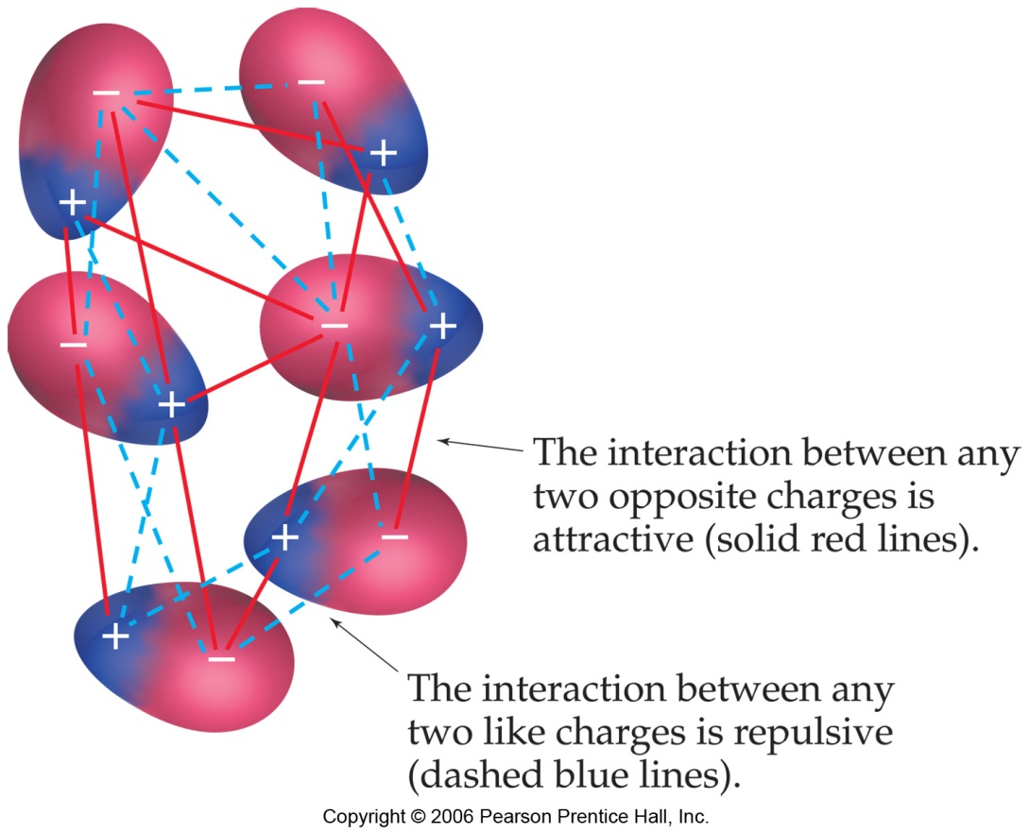
Dipole-Dipole Forces
Molecules that have permanent dipoles are attracted to each other.
  The positive end of one is attracted to the negative end of the other and vice-versa.
  These forces are only important when the molecules are close to each other.
  Weaker than ion-dipole forces

Slide 12
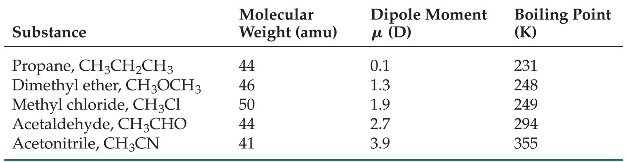
Dipole-Dipole Interactions
At about equal masses, the more polar the molecule, the higher is its boiling point.

Slide 13
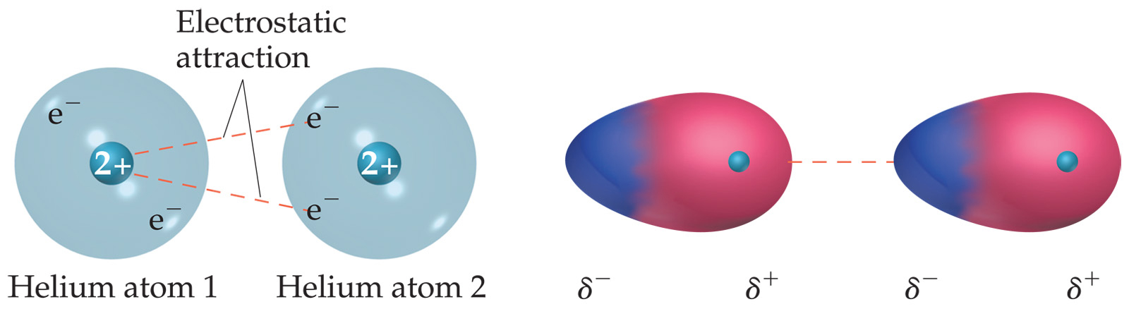
London Dispersion Forces
Occurs in NONPOLAR atoms/molecules
Motion of electrons in atom/molecule can create momentary dipole moments
Happens when electrons wind up on same side of atom (temporary dipole moment…think momentarily polar)
This can cause a temporary attraction as shown:

Slide 14
London Dispersion Forces
Attractions between an instantaneous dipole and an induced dipole
These forces are present in all molecules, whether they are polar or nonpolar.
The tendency of an electron cloud to distort in this way is called polarizability.

Slide 15
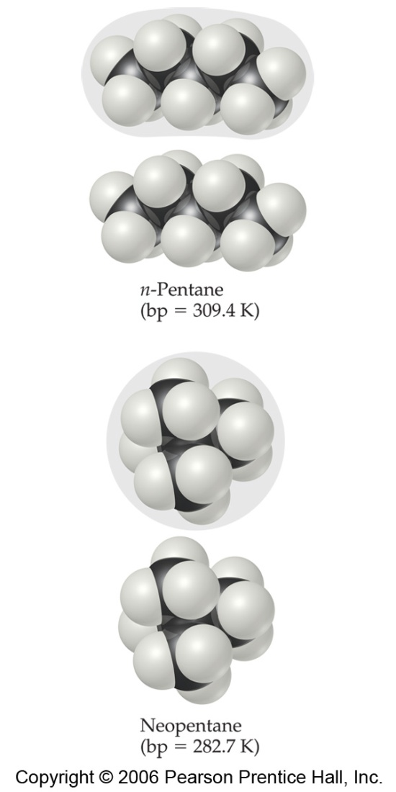
Factors Affecting London Forces
The shape of the molecule affects the strength of dispersion forces: long, skinny molecules (like n-pentane tend to have stronger dispersion forces short, fat ones (like neopentane).
This is due to the increased surface area in n-pentane.

Slide 16
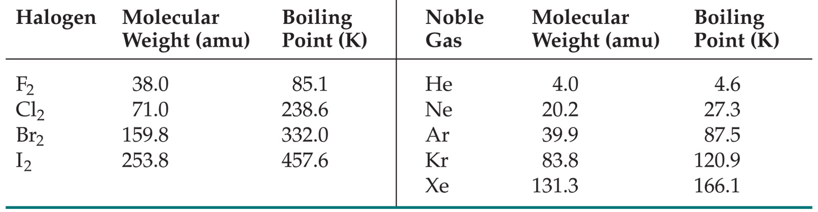
Factors Affecting London Forces
The strength of dispersion forces tends to increase with increased molecular weight.
Larger atoms have larger electron clouds, which are easier to polarize.

Slide 17
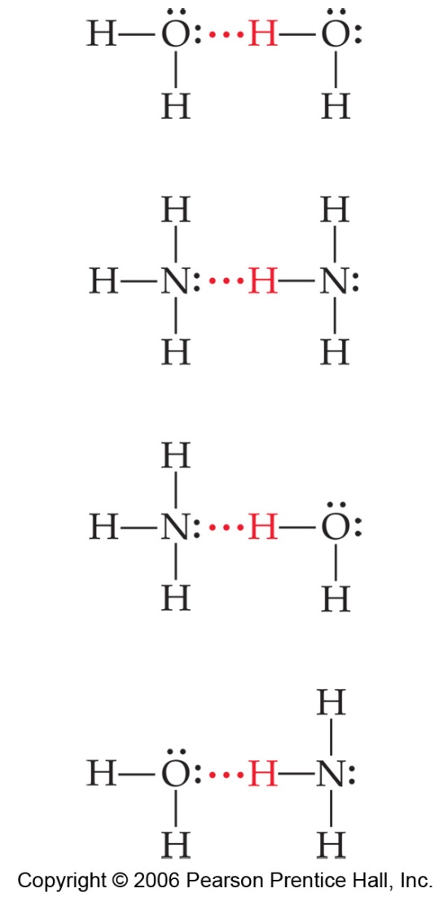
Hydrogen Bonding
The dipole-dipole interactions experienced when H is bonded to N, O, or F are unusually strong.
We call these interactions hydrogen bonds.

Slide 18
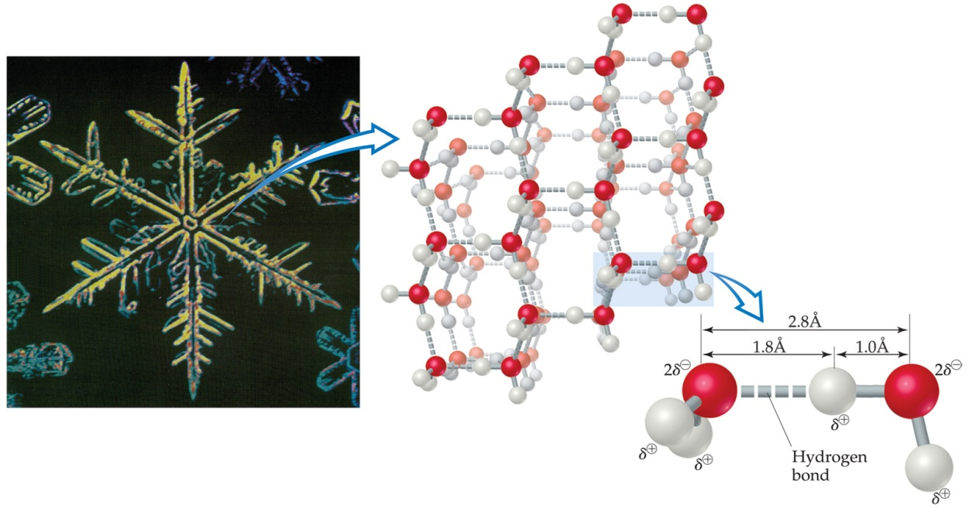
Hydrogen Bonding
Hydrogen bonding arises in part from the high electronegativity of nitrogen, oxygen, and fluorine.
Also, when hydrogen is bonded to one of those very electronegative elements, the hydrogen nucleus is exposed.

Slide 19
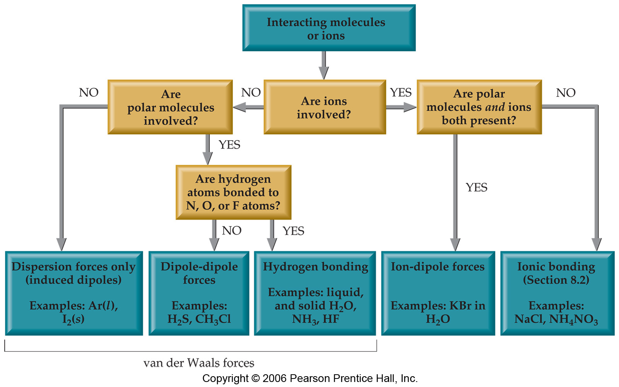
Summarizing Intermolecular Forces

Slide 20
Ability to form Homogeneous Mixtures (dissolve)
“Like dissolves like”
Nonpolar will dissolve in nonpolar
Polar will dissolve in polar
Ionic will dissolve in polar

